Slide 1


Orchestrating Your Future Ready Enterprise
Capabilities & Offerings
Jan 2026

Slide 2










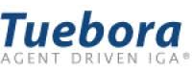









THE FIRM
Saints & Masters is a global technology advisory and execution firm. We architect digital sovereignty for the enterprise, combining the agility of a startup with the rigor of a global consultancy.
OUR PROPOSITION
OUR METHODOLOGY
We do not just advise; we execute. From bare-metal infrastructure to autonomous AI agents, we own the outcome. We bridge the gap between "Strategy" and "Engineering".
Orchestration. We integrate best-in-class enterprise platforms along with our proprietary IP to architect, deploy and run secure, scalable and sovereign solutions across cloud, data, AI and business systems..
OUR PARTNERS
OUR PRESENCE
India
US
Canada
UK
Singapore
Australia
Macedonia
Slovenija

Slide 3







OUR CAPABILITIES
Hyperscaler Orchestration
Data Practice Modernisation
Architecture, migration, and operations across Microsoft Azure, AWS, and hybrid environments, including workload placement, governance, FinOps, and cross-cloud connectivity.
Modernize with cloud-native data platforms built on Snowflake, Databricks, and Couchbase, enabling real-time analytics, AI enablement, data sharing, and unified data governance.
Sovereign Infra & IaaS
Cyber Security Resilience
Private cloud, colocation and enterprise IaaS delivered from Equinix data centres globally, enabling data residency, high availability, secure interconnection, and predictable operating costs.
Integrated identity, network, endpoint, and cloud security using Zero-Trust architectures, continuous monitoring, and automated threat detection and response.
Agentic AI Platform
Business OS
Design, deployment, and governance of autonomous AI agents- from task assistants to multi-agent orchestrators- integrated into enterprise systems with full security and audit controls.
Implementation and operation of a unified enterprise business platform covering CRM, finance, HR, IT service management, and analytics on a single integrated stack.
© Copyright Saints and Masters. All rights reserved. No part of this presentation may be reproduced in part or full

Slide 4

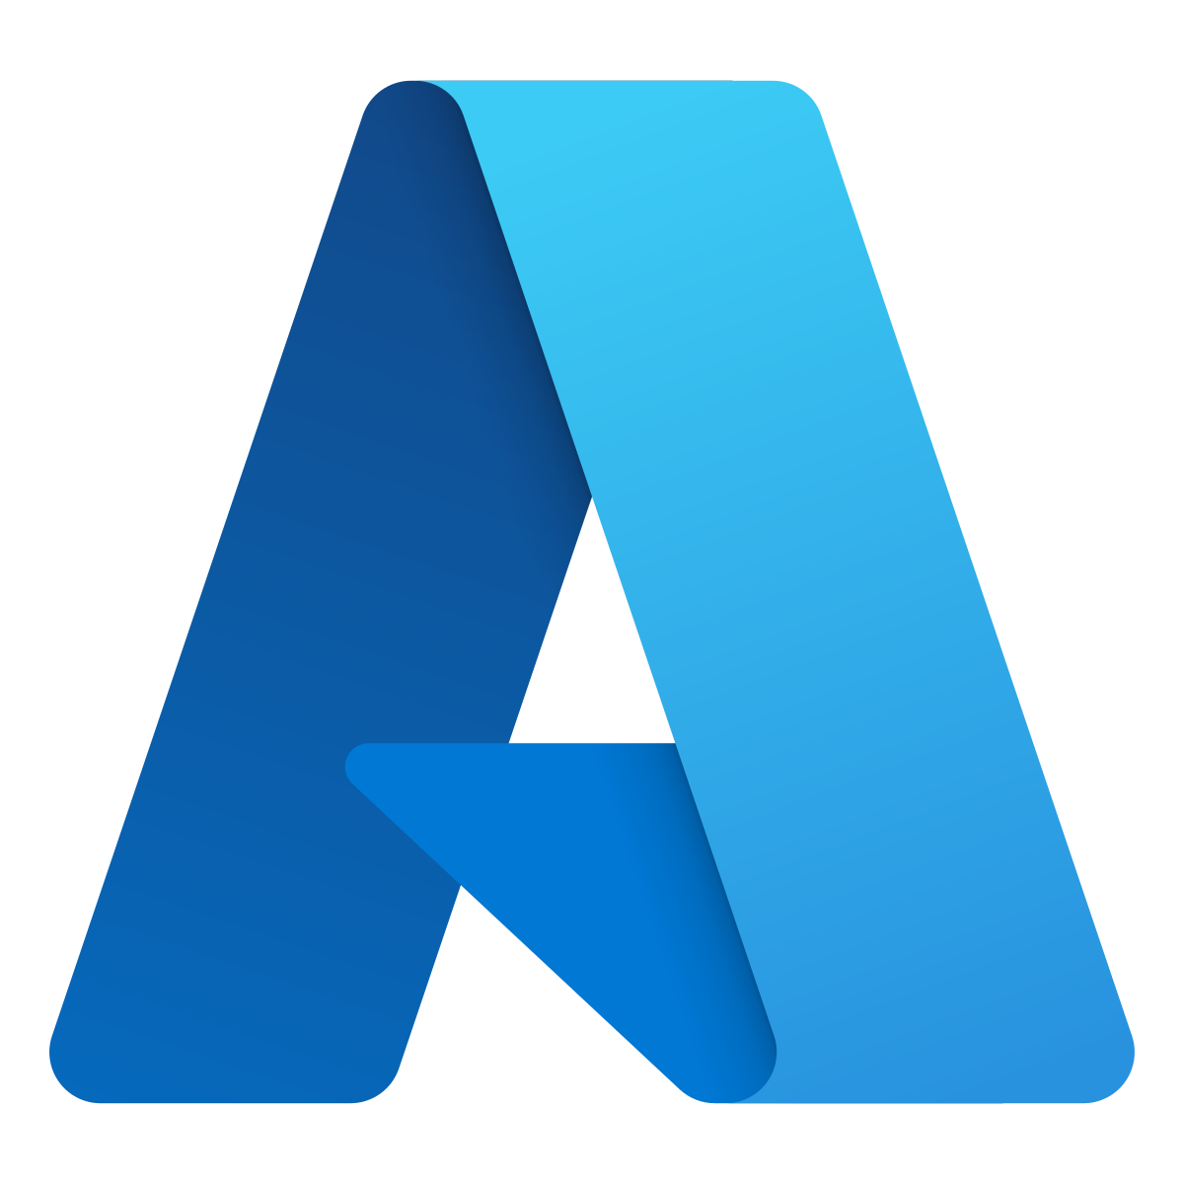

HYPERSCALER ORCHESTRATION
Architecting and operating cloud platforms across Azure, AWS,and hybrid enterprise environments
MICROSOFT AZURE
AMAZON WEB SERVICES
We deliver across the Microsoft estate aligned to its core platform pillars- Azure, Data & AI, Securityand Modern Work, enabling integrated, enterprise-wide transformation
We deliver across AWS service domains- compute, storage, networking, data, and cloud-native services, building scalable, resilient environments.
End-to-end Azure, Data, AI, Security, and Modern Work delivery
Full-spectrum delivery across IaaS, containers, serverless and data platforms
Large-scale migrations, modernization and platform engineering
Proven legacy-to-modern transformation at scale
Deep experience across PaaS, Fabric, Copilot and enterprise security
Deep operational experience with AWS-native services and architectures
Microsoft-native governance, compliance, and operating models
Continuous optimization aligned to AWS Well-Architected Framework
Multi-Cloud & Hybrid Orchestration
Workload Placement
Platform Architecture
Hybrid Integration
Cloud FinOps
Best-fit services across Azure, AWS, private cloud, and on-prem
Hyperscale-native designs with cross-cloud experience
Public cloud, private cloud, and data centre connectivity
Cost visibility, optimization, and commitment management
© Copyright Saints and Masters. All rights reserved. No part of this presentation may be reproduced in part or full

Slide 5


SOVERIGN INFRASTRUCTURE
Enterprise-Grade Infrastructure with High Availability, Control, and Predictable Economics
DATA CENTRES & INTERCONNECTION
IAAS
Enterprise-Grade Colocation with Industry-Leading Uptime
Private Cloud with Full Control and Predictable Economics
We act as a specialized reseller for Equinix, focusing on high-performance interconnection rather than just colocation.
Saints & Masters operates a private cloud within Equinix for enterprises requiring control, data residency and predictable cost.
What we offer
What we offer
Secure, carrier-neutral data centre racks within Equinix facilities
Predictable, highly resilient physical infrastructure
Direct, private interconnection to cloud providers, networks, and enterprises
Dedicated and shared cloud models
Fully managed compute, storage and networking
Tenant-level isolation, security and governance
Hosted in Equinix DCs globally, enterprise-grade infrastructure
Outcomes
Outcomes
Enables hybrid and multi-cloud architectures with low latency
Designed for business-critical workloads requiring continuous availability
Backed by industry-leading uptime commitments (up to 99.999%)
Data residency and sovereignty by design
Predictable OpEx with controlled egress
Cost-efficient options without loss of control
Fit for regulated and business-critical workloads
© Copyright Saints and Masters. All rights reserved. No part of this presentation may be reproduced in part or full

Slide 6









OPERATIONALIZING AGENTIC AI
From Task Automation to Autonomous Agentic work- anchored by enterprise grade trust and agnostic infrastructure
1. Assistive Agents
2. Process Agents
3. Orchestrator Agents
Task-specific "Copilots" designed to augment individual human productivity. They execute single-turn instructions with high precision.
Workflow-centric "Specialists" that chain multiple tasks together to automate end-to-end business processes within a specific domain.
Goal-seeking "Strategists" that manage other agents, make cross-domain decisions, and optimize outcomes without prescriptive rules.
USE CASE EXAMPLES
USE CASE EXAMPLES
USE CASE EXAMPLES
Code Generation & Review
Meeting Summarization
Email Drafting
Claims Processing
HR Onboarding
IT Incident Triage
Supply Chain Re-routing
Dynamic Cloud Optimization
AI assisted Security Defense
Enterprise Trust
Guardrails
PII Redaction & Data Masking
Full Audit Traceability
RBAC & Identity Enforcement
Deployment Flexibility
Hyperscaler Native (AWS Bedrock, Azure AI, GCP)
Sovereign Infrastructure (On-Prem, Private DC)
© Copyright Saints and Masters. All rights reserved. No part of this presentation may be reproduced in part or full

Slide 7






DATA PRACTICE MODERNIZATION
Integrate best-of-breed data platforms to power the next generation of AI-ready enterprises.
THE DATA CLOUD
DATA INTELLIGENCE
OPERATIONAL VELOCITY
POWERED BY SNOWFLAKE
POWERED BY DATABRICKS
POWERED BY COUCHBASE
Breaking down silos with a cloud-native architecture that enables limitless scaling and secure sharing.
Unifying data warehouses and data lakes to democratize data and AI across the organization.
Delivering sub-millisecond responsiveness for mission-critical applications at the edge.
>
>
>
Elastic Warehousing: Separate compute from storage for instant scalability.
Lakehouse Architecture: The best of data warehouses on a data lake.
Edge Sync: "Offline-first" mobile capabilities.
>
>
>
Zero-Copy Sharing: Live data access across the ecosystem without ETL.
Mosaic AI: Training and deploying custom GenAI models.
High Performance: Memory-first architecture for speed.
>
>
>
Snowpark: Optimized pipelines for data engineering
Unity Catalog: Unified governance for all data assets.
Vector Search: Real-time context for AI apps.
40%
3x
0
LOWER TCO
SPEED TO MARKET
DATA SILOS
© Copyright Saints and Masters. All rights reserved. No part of this presentation may be reproduced in part or full

Slide 8









CYBER SECURITY RESILIENCE
Integrate modern security platforms to build a resilient, Zero-Trust enterprise.
Adaptive Identity
Unified IT Ops
POWERED BY TUEBORA
POWERED BY MANAGEENGINE &
Self-Driving IGA Automated micro-certifications & risk scoring to reduce fatigue.
Event-Driven JML Real-time provisioning triggered directly via HR systems.
360° Visibility Integrated SIEM & Endpoint Management for total control.
Privileged Access Just-in-Time (JIT) admin controls with session recording.
Zero Trust Edge
Intelligent SOC
POWERED BY ZSCALER
MANAGED DEFENSE
Secure Service Edge Direct-to-app connectivity that eliminates VPN attack surface.
Cyber Sandbox AI-driven zero-day payload analysis and quarantine.
Threat Hunting Proactive sweeping for hidden IOCs/IOAs.
Auto-Response SOAR-driven containment & host isolation.
© Copyright Saints and Masters. All rights reserved. No part of this presentation may be reproduced in part or full

Slide 9





BUSINESS OS
Run the entire enterprise on one unified, intelligent business platform.
Customer Experience
Finance & Ops
Collab & HR
IT, Support & BI
Unified journey from anonymous visitor to loyal advocate.
Back-office efficiency with global tax compliance.
Empowering talent from hiring to retirement.
Extend capabilities with low-code & custom apps.
CRM
Campaigns
SalesIQ
Books
Expense
Invoice
Mail
Cliq
Meeting
Desk
Lens
Assist
Forms
Sites
Survey
Inventory
Subscriptions
Checkout
Workdrive
People
Recruit
Service Desk
Creator
Analytics
PageSense
Backstage
Loyalty
Contracts
Payroll
Commerce
Writer
Connect
Notebook
Flow
Vault
Directory
Marketing Auto.
Bigin
Projects
Sprints
Commerce
Learn
Powered by:
The Unified Core Operating System Services
Zia AI Intelligence
Unified Search (Zia)
IAM & Security
Analytics Engine
© Copyright Saints and Masters. All rights reserved. No part of this presentation may be reproduced in part or full

Slide 10


Global Presence, Unified Delivery
  Global Sales & Partnerships: Our 7 key market offices focus on sales, presales and strategic partner development.
  40+ individuals are dedicated to driving sales and engaging customers globally
  We leverage strong relationships with 10+ Go-to-Market (GTM) partners to accelerate client acquisition and solutions delivery
Centralized Delivery Hub: Our core delivery and support team operates primarily from India, ensuring cost-effective, high-quality project execution.
  This includes a dedicated 250+ member delivery team working from hubs like Bengaluru, Chennai and Kochi
London
Ljubljana
Toronto
Skopje
Detroit
Singapore
Bengaluru
Kochi
Chennai
Sydney

Slide 11


Orchestrate
Your Future
Get in Touch
www.saintsandmasters.com
Info@saintsandmasters.com
Disclaimer
All rights reserved. No part of this presentation, including its content, frameworks, or brand assets, may be copied, reproduced, distributed, or transmitted in any form without prior written permission of Saints and Masters.
Any unauthorized use, reproduction, or misrepresentation will be pursued and remedied through appropriate legal action.

